Slide 1
A new learning algorithm for SLFN with binary-value inputs, ReLU & binary-value desired output
國立政治大學 資訊管理學系
蔡瑞煌 特聘教授

Slide 2
development (Algorithm - Wikipedia)
Typical steps in the development of algorithms:
Problem definition
Development of a model
Specification of the algorithm
Designing an algorithm
Checking the correctness of the algorithm
Analysis of algorithm
Implementation of algorithm
Program testing
Documentation preparation
This course focuses on the AI application problems.
The new learning algorithm is designed to get the effectiveness and the efficiency.
2

Slide 3
Eight kinds of AI application problems
A new learning algorithm for SLFN with binary-value inputs, ReLU and single binary-value desired output (bi_ReLU_sbo)
A new learning algorithm for SLFN with binary-value inputs, ReLU and single real-value desired output (bi_ReLU_sro)
A new learning algorithm for SLFN with real-value inputs, ReLU and single binary-value desired output (ri_ReLU_sbo)
A new learning algorithm for SLFN with real-value inputs, ReLU and single real-value desired output (ri_ReLU_sro)
A new learning algorithm for SLFN with binary-value inputs, ReLU and multiple binary-value desired output (bi_ReLU_mbo)
A new learning algorithm for SLFN with binary-value inputs, ReLU and multiple real-value desired output (bi_ReLU_mro)
A new learning algorithm for SLFN with real-value inputs, ReLU and multiple binary-value desired output (ri_ReLU_mbo)
A new learning algorithm for SLFN with real-value inputs, ReLU and multiple real-value desired output (ri_ReLU_mro)

Slide 4
AI Application Problem
(bi_ReLU_sbo)
• Single Proton Emission Computed Tomography (SPECT)
heart diagnosis data set (Kurgan, et al., 2001; UCI Machine Learning)
• 267 instances (55 normal samples, and 212 abnormal samples)
• Positive: normal
Negative: abnormal
Training data set | Amount of positive samples | 40
 | Amount of negative samples | 40
Testing data set | Amount of positive samples | 15
 | Amount of negative samples | 172
Total amount of samples |  | 267
• 23 attributes
(x: 22 (binary) attributes,
y: 1 (binary) attribute)
• y: Binary (normal: 0, abnormal: 1)
4

Slide 5
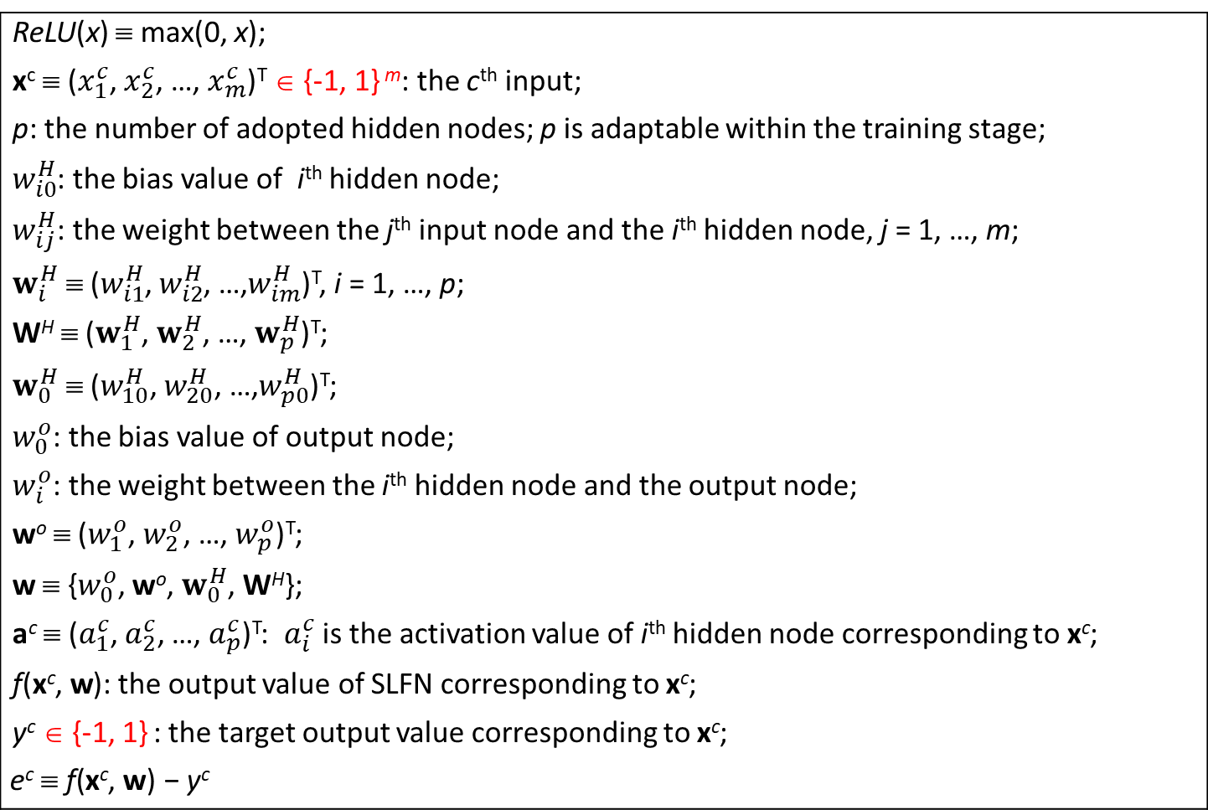
Assumption: the adaptive network
The network setting:
Two-layer nets / SLFN / One-hidden-layer nets
ReLU(x) ≡ max(0, x); x^{c} ≡ ($x_{1}^{c}$, $x_{2}^{c}$, …, $x_{m}^{c}$)^{T} ∈ {-1, 1} ^{m}: the c^{th} input; p: the number of adopted hidden nodes; p is adaptable within the training stage; $w_{i0}^{H}$: the bias value of i^{th} hidden node; $w_{ij}^{H}$: the weight between the j^{th} input node and the i^{th} hidden node, j = 1, …, m; $w_{i}^{H}$ ≡ ($w_{i1}^{H}$, $w_{i2}^{H}$, …,$w_{im}^{H}$)^{T}, i = 1, …, p; W^{H} ≡ ($w_{1}^{H}$, $w_{2}^{H}$, …, $w_{p}^{H}$)^{T}; $w_{0}^{H}$ ≡ ($w_{10}^{H}$, $w_{20}^{H}$, …,$w_{p0}^{H}$)^{T}; $w_{0}^{o}$: the bias value of output node; $w_{i}^{o}$: the weight between the i^{th} hidden node and the output node; wº ≡ ($w_{1}^{o}$, $w_{2}^{o}$, …, $w_{p}^{o}$)^{T}; w ≡ {$w_{0}^{o}$, wº, $w_{0}^{H}$, W^{H}}; a^{c} ≡ ($a_{1}^{c}$,${ a}_{2}^{c}$, …, $a_{p}^{c}$)^{T}: $a_{i}^{c}$ is the activation value of i^{th} hidden node corresponding to x^{c}; f(x^{c},$\text{w}$): the output value of SLFN corresponding to x^{c}; y^{c} ∈ {-1, 1} : the target output value corresponding to x^{c}; $$\text{e}\text{c} \text{≡ }\text{f}\text{(}\text{x}\text{c}\text{,} \text{w}\text{)}\text{ − }\text{y}\text{c}$$
5

Slide 6

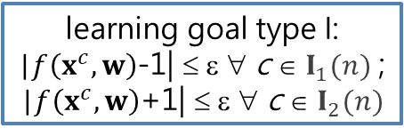

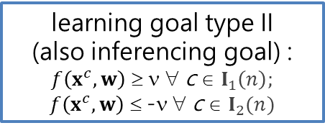

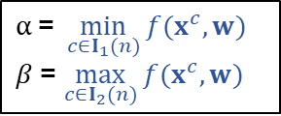



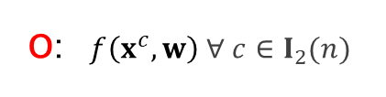



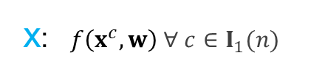
The learning goal of the n^{th} stage
y^{c} = 1 $∀ c∈I_{1}$(n); y^{c} = -1 $∀ c∈I_{2}$(n);$I$(n) ≡ $I_{1}$(n) ∪ $I_{2}$(n)
classification problems
x: $f\left(x^{c},w\right) ∀ c∈I_{1}(n)$
learning goal type I:
|$f\left(x^{c},w\right)$-1| ≤ ε ∀ c ∈ $I_{1}(n)$ ;
|$f\left(x^{c},w\right)$+1| ≤ ε ∀ c ∈ $I_{2}(n)$
o: $f\left(x^{c},w\right) ∀ c∈I_{2}(n)$
$$−1$$
1
o
o
o
x
o
x
x
x
$$α \text{=} \min_{c∈I_{1}(n)}{f(x^{c},w)}$$
$β$= $\max_{c∈I_{2}(n)}{f(x^{c},w)}$
$$f\left(x^{c},w\right)$$
|e^{c}| $≤\text{ε}$ ∀ c
Undecided
$$−v$$
$$v$$
learning goal type II
(also inferencing goal) :
$f\left(x^{c},w\right)$ ≥ ν ∀ c ∈ $I_{1}\left(n\right);$ $f\left(x^{c},w\right)$ ≤ -ν ∀ c ∈ $I_{2}(n)$
The classification inferencing module
o
o
o
o
x
x
x
x
$$f\left(x^{c},w\right)$$
Undecided
ν Is a hyperparameter regarding the inferencing!
$$β$$
$$α$$
learning goal type III: SeC
o
o
o
x
x
o
x
x
$$f\left(x^{c},w\right)$$

Slide 7


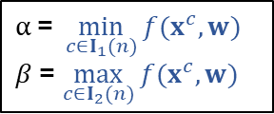

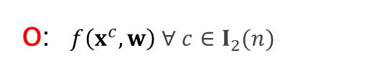


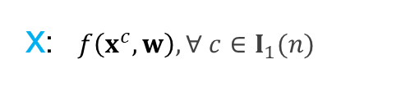



The acceptance is based on |e^{c}| $≤\text{ε}$ $∀ c∈I$
Acceptance is applied to not only the SLFN but also each individual training data.
learning goals
The acceptance is based on the SeC
y^{c} = 1 $∀ c∈I_{1}$(n); y^{c} = -1 $∀ c∈I_{2}$(n);$I$(n) ≡ $I_{1}$(n) ∪ $I_{2}$(n)
x: $f\left(x^{c},w\right), ∀ c∈I_{1}(n)$
$$α \text{=} \min_{c∈I_{1}(n)}{f(x^{c},w)}$$
$β$= $\max_{c∈I_{2}(n)}{f(x^{c},w)}$
$$α$$
$$β$$
o: $f\left(x^{c},w\right) ∀ c∈I_{2}(n)$
o
o
x
o
x
o
x
x
$$β$$
$$α$$
$$f\left(x^{c},w\right)$$
$$α$$
$$β$$
o
o
o
x
x
o
x
x
$$f\left(x^{c},w\right)$$
o
o
o
x
x
o
x
x
$$f\left(x^{c},w\right)$$
SeC: True
SeC: False

Slide 8




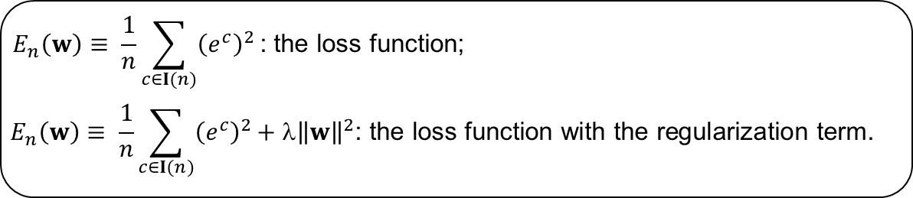
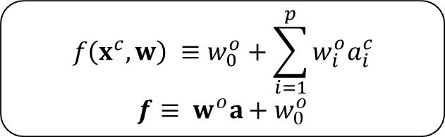
The forward operation setting
Forward operation
Hidden Layer
The hidden layer:
i
$$a_{i}^{c}≡\operatorname{ReLU}\left(w_{i0}^{H}+\sum_{j=1}^{m}{w_{ij}^{H}}x_{j}^{c}\right)$$
$$a≡\operatorname{ReLU}\left(W^{H}x+w_{0}^{H}\right)$$
Input Layer
$$x_{1}$$
$$x_{2}$$
$$x_{3}$$
…
$$x_{m}$$
Output Layer
1
The output layer:
$$f\left(x^{c},w\right) ≡w_{0}^{o}+\sum_{i=1}^{p}{w_{i}^{o}a_{i}^{c}}$$
$$f≡{ w}^{o}a+w_{0}^{o}$$
Hidden Layer
1
2
…
p
$$E_{n}\left(w\right)≡ \frac{1}{n}\sum_{c∈I(n)}{{\left(e^{c}\right)}^{2}}\text{: }\text{the} \text{loss} \text{function}\text{;}$$
$$E_{n}\left(w\right)≡ \frac{1}{n}\sum_{c∈I(n)}{{\left(e^{c}\right)}^{2}}\text{+ }\text{λ}{\left\|w\right\|}^{2}\text{: }\text{the} \text{loss} \text{function} \text{with} \text{the} \text{regularization} \text{term}\text{.}$$
Notes:
The Single-hidden layer Feedforward Neural Networks (SLFN) structure

Slide 9
development (Algorithm - Wikipedia)
Typical steps in the development of algorithms:
Problem definition
Development of a model
Specification of the algorithm
Designing an algorithm
Checking the correctness of the algorithm
Analysis of algorithm
Implementation of algorithm
Program testing
Documentation preparation

Slide 10
The proposed learning algorithm
(in flowchart)
True
n ≥ N
False
Selecting module
learning goal
False
Save w
True
Matching module
A
n ++
Reorganizing module
Cramming module
Restore w
B
Initializing module
10

Slide 11
The proposed learning algorithm
(in flowchart)
True
n ≥ N
False
Selecting module
learning goal
False
Save w
True
A
Matching module
n ++
Reorganizing module
Cramming module
Restore w
B
Initializing module
11

Slide 12
The proposed learning algorithm
(in flowchart)
True
n ≥ N
False
Selecting module
learning goal
False
Save w
True
Matching module
A
n ++
Reorganizing module
Cramming module
Restore w
B
Initializing module
12

Slide 13
The proposed learning algorithm
(in flowchart)
True
n ≥ N
False
Selecting module
learning goal
False
Save w
True
Matching module
A
n ++
Reorganizing module
Cramming module
Restore w
B
Initializing module
13

Slide 14
Difficulties
Matching
Regularizing
Reorganizing
Cramming
Selecting
Initializing
…
Optimization methods: much harder to be proved by mathematical proofs, but much easier to be tried by CS coding.
Rule-based methods: much easier to be proved by mathematical proofs, but the validation is usually required and is difficult sometimes.

Slide 15
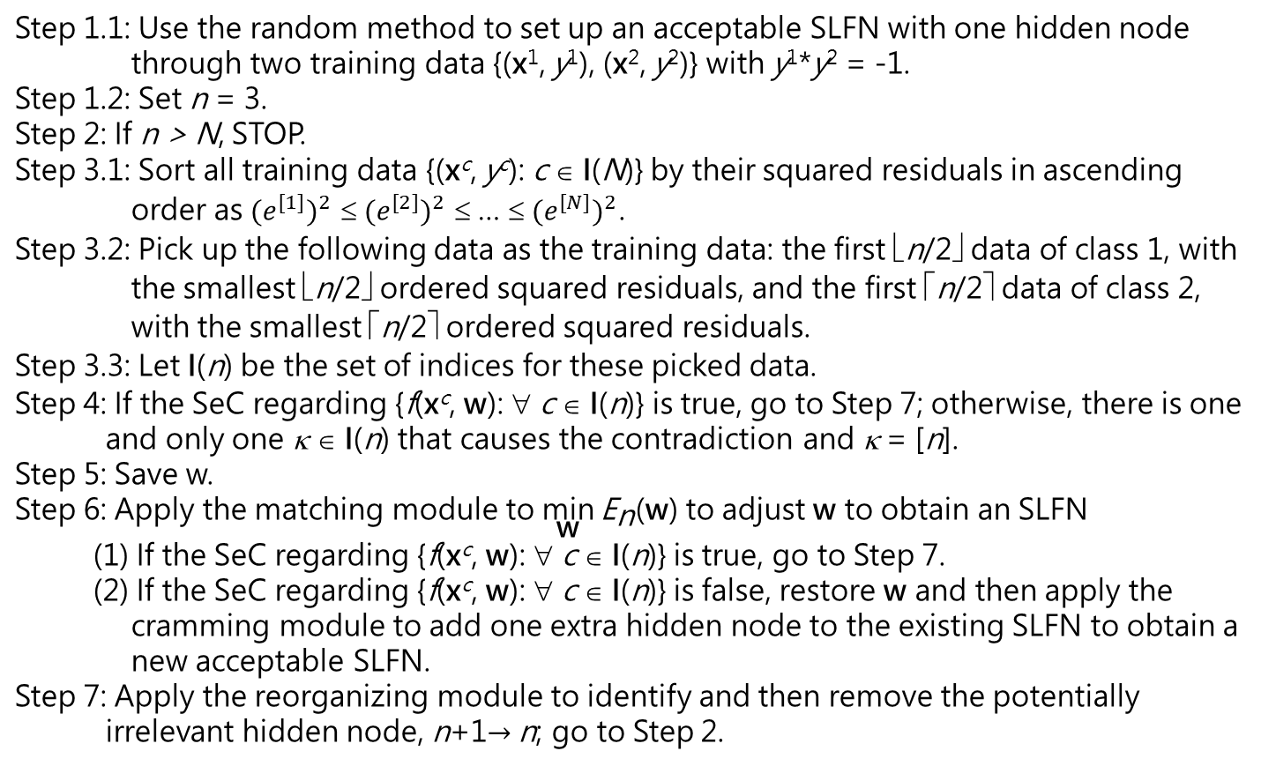
The proposed learning algorithm
Step 1.1: Use the random method to set up an acceptable SLFN with one hidden node through two training data {(x¹, y¹), (x², y²)} with y¹*y² = -1. Step 1.2: Set n = 3. Step 2: If n > N, STOP. Step 3.1: Sort all training data {(x^{c}, y^{c}): c ∈ I(N)} by their squared residuals in ascending order as ${(e^{[1]})}^{2}$ ≤ ${(e^{[2]})}^{2}$ ≤ … ≤ ${(e^{[N]})}^{2}$. Step 3.2: Pick up the following data as the training data: the first ⎣n/2⎦ data of class 1, with the smallest ⎣n/2⎦ ordered squared residuals, and the first ⎡n/2⎤ data of class 2, with the smallest ⎡n/2⎤ ordered squared residuals. Step 3.3: Let I(n) be the set of indices for these picked data. Step 4: If the SeC regarding {f(x^{c}, w): ∀ c ∈ I(n)} is true, go to Step 7; otherwise, there is one and only one κ ∈ I(n) that causes the contradiction and κ = [n]. Step 5: Save w. Step 6: Apply the matching module to $\underset{\text{w}}{\text{min}}{{\text{E}}_{\text{n}}\text{(}\text{w}\text{)}}$ to adjust w to obtain an SLFN (1) If the SeC regarding {f(x^{c}, w): ∀ c ∈ I(n)} is true, go to Step 7. (2) If the SeC regarding {f(x^{c}, w): ∀ c ∈ I(n)} is false, restore w and then apply the cramming module to add one extra hidden node to the existing SLFN to obtain a new acceptable SLFN. Step 7: Apply the reorganizing module to identify and then remove the potentially irrelevant hidden node, n+1$→$n; go to Step 2.
initializing
math validation ok
stopping criterion
Rule-based methods: much easier to be proved by mathematical proofs, but the validation is usually required and difficult.
selecting
math validation required ← ???
learning goal
math validation required ← ???

Slide 16

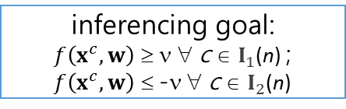


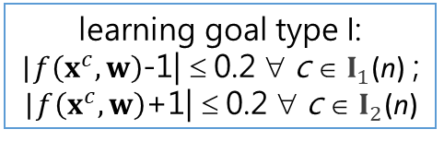
The learning goal of the n^{th} stage
y^{c} = 1 $∀ c∈I_{1}$(n); y^{c} = -1 $∀ c∈I_{2}$(n);$I$(n) ≡ $I_{1}$(n) ∪ $I_{2}$(n)
learning goal type I:
|$f\left(x^{c},w\right)$-1| ≤ 0.2 ∀ c ∈ $I_{1}$(n) ;
|$f\left(x^{c},w\right)$+1| ≤ 0.2 ∀ c ∈ $I_{2}$(n)
$$−1$$
1
o
o
o
x
o
x
x
x
$$f\left(x^{c},w\right)$$
|e^{c}| $≤\text{0.2}$ ∀ c
Undecided
$$−v$$
$v$=0.8
inferencing goal:
$f\left(x^{c},w\right)$ ≥ ν ∀ c ∈ $I_{1}$(n) ; $f\left(x^{c},w\right)$ ≤ -ν ∀ c ∈ $I_{2}$(n)
The classification inferencing module
o
o
o
o
x
x
x
x
$$f\left(x^{c},w\right)$$
Undecided
The acceptance is based on |e^{c}| $≤\text{0.2}$ ∀ c
Acceptance is applied to not only the SLFN but also each individual training data.

Slide 17
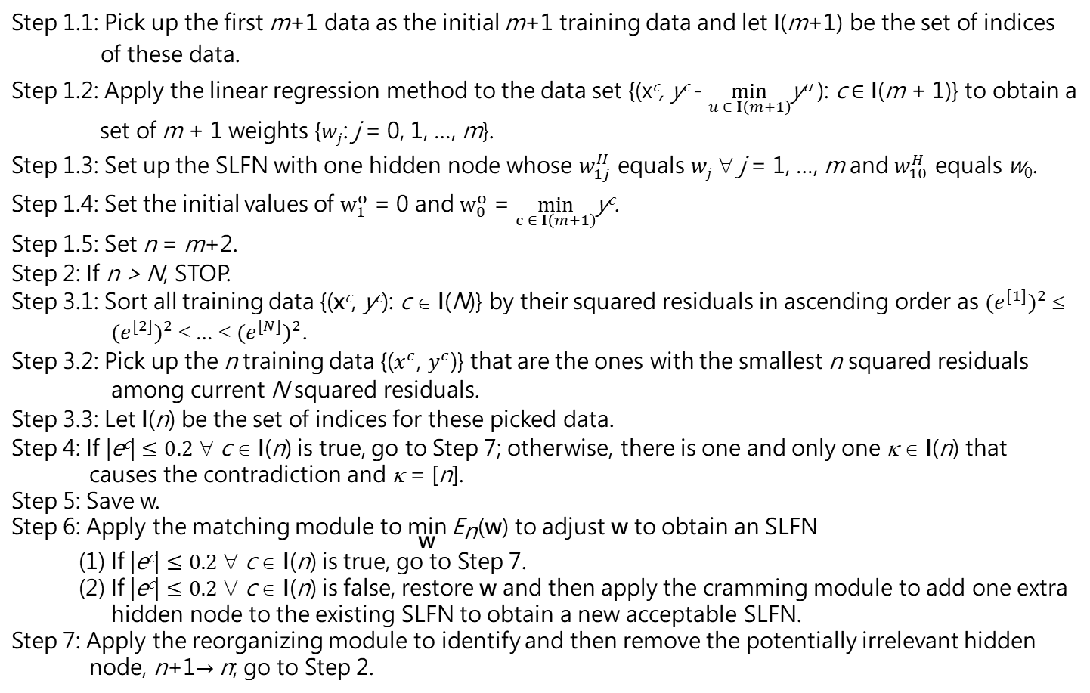
The proposed learning algorithm
Step 1.1: Pick up the first m+1 data as the initial m+1 training data and let I(m+1) be the set of indices of these data. Step 1.2: Apply the linear regression method to the data set {(x^{c}, y^{c} - $\min_{u ∈ I\left(m+1\right)}$y^{u} ): c ∈ I(m + 1)} to obtain a set of m + 1 weights {$wj$: j = 0, 1, …, m}. Step 1.3: Set up the SLFN with one hidden node whose $w_{1j}^{H}$ equals $wj$ ∀ j = 1, …, m and $w_{10}^{H}$ equals w₀. Step 1.4: Set the initial values of $w_{1}^{o}$ = 0 and $w_{0}^{o}$ = $\min_{c ∈ I\left(m+1\right)}$y^{c}. Step 1.5: Set n = m+2. Step 2: If n > N, STOP. Step 3.1: Sort all training data {(x^{c}, y^{c}): c ∈ I(N)} by their squared residuals in ascending order as ${(e^{[1]})}^{2}$ ≤ ${(e^{[2]})}^{2}$ ≤ … ≤ ${(e^{[N]})}^{2}$. Step 3.2: Pick up the n training data {($x^{c}$, $y^{c}$)} that are the ones with the smallest n squared residuals among current N squared residuals. Step 3.3: Let I(n) be the set of indices for these picked data. Step 4: If |e^{c}| $≤0.2$ ∀ c ∈ I(n) is true, go to Step 7; otherwise, there is one and only one κ ∈ I(n) that causes the contradiction and κ = [n]. Step 5: Save w. Step 6: Apply the matching module to $\underset{\text{w}}{\text{min}}{{\text{E}}_{\text{n}}\text{(}\text{w}\text{)}}$ to adjust w to obtain an SLFN (1) If |e^{c}| $≤0.2$ ∀ c ∈ I(n) is true, go to Step 7. (2) If |e^{c}| $≤0.2$ ∀ c ∈ I(n) is false, restore w and then apply the cramming module to add one extra hidden node to the existing SLFN to obtain a new acceptable SLFN. Step 7: Apply the reorganizing module to identify and then remove the potentially irrelevant hidden node, n+1$→$n; go to Step 2.
initializing
math validation ok
stopping criterion
selecting
math validation ok
learning goal
math validation ok

Slide 18
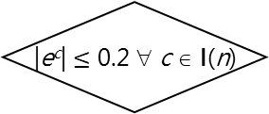
The proposed learning algorithm
(in flowchart)
True
n ≥ N
False
Selecting module
|e^{c}| $≤\text{0.2}$ ∀ c ∈ I(n)
False
Save w
True
Matching module
A
n ++
Reorganizing module
Cramming module
Restore w
B
Initializing module
18

Slide 19

The initializing module for the case of real-value desired output & ReLU
Step 1: Pick up the first m+1 data as the initial m+1 training data and let I(m+1) be the set of indices of these data.
Step 2: Apply the linear regression method to the data set {(x^{c}, y^{c} - $\min_{u ∈ I\left(m+1\right)}$y^{u} ), c ∈ I(m + 1)} to obtain a set of m + 1 weights {$wj$, j = 0, 1, …, m}.
Step 3: Set up the SLFN with one hidden node whose $w_{1j}^{H}$ equals $wj$ ∀ j = 1, …, m and $w_{10}^{H}$ equals w₀.
Step 4: Set the initial values of $w_{1}^{o}$ = 0 and $w_{0}^{o}$ = $\min_{c ∈ I\left(m+1\right)}$y^{c}.
In Step 2, the corresponding set of simultaneous linear equations is a system of m + 1 linear equations in m + 1 unknowns:
w₀ + $\sum_{j=1}^{m}{wj{ x}_{j}^{c}}=$ y^{c} - $\min_{u∈ I\left(m+1\right)}$y^{u} ∀ c ∈ I(m + 1)
This setup of SLFN renders (e^{c})² = 0 ∀ c ∈ I(m + 1)

Slide 20

The selecting module with LTS
The stopping criterion
If n > N, STOP.
At the n^{th} stage,
Step 1: Sort all N training data based upon the squared residual (e^{c})² values.
Step 2: Select the n training data {($x^{c}$, $y^{c}$)} that are the ones with the smallest n squared residuals among current N squared residuals.
Step 3: Let I(n) be the set of indices of these data.

Slide 21
The learning goal
|e^{c}| $≤\text{0.2}$ ∀ c ∈ I(n)
The save module
Save w
The restore module
Restore the saved w

Slide 22
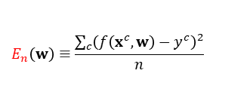
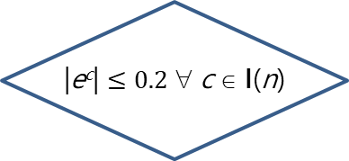
The matching module
helps tune weights to obtain an acceptable net.
Hyperparameters:
100
Optimizer (Adam)
ε = 0.2
i = 1
$$E_{n}\left(w\right)≡\frac{\sum_{c}{{\left(f\left(x^{c},w\right)−y^{c}\right)}^{2}}}{n}$$
i++
forward
operation
False
i ≥ 100
|e^{c}| $≤0.2$ ∀ c ∈ I(n)
backward operation
False
True
True
B
Unacceptable net
Acceptable net
A

Slide 23


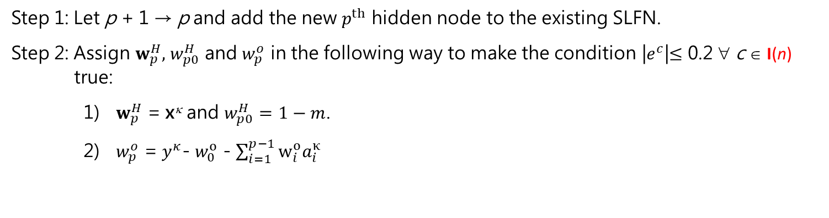
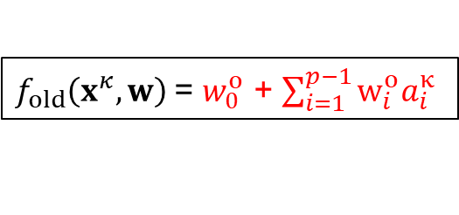

The cramming module
Where we are now...
Step 1: Let p + 1 → p and add the new $p^{th}$ hidden node to the existing SLFN.
Step 2: Assign $w_{p}^{H},$ $w_{p0}^{H}$ and $w_{p}^{o}$ in the following way to make the condition |$e^{c}$|$≤$ 0.2 ∀ c ∈ $\text{I}\text{(}\text{n}\text{)}$ true:
${ w}_{p}^{H}$ = x^{κ} and $w_{p0}^{H}=1−m$.
${ w}_{p}^{o}$ = $y^{κ}$- $w_{0}^{o}$ - $\sum_{i=1}^{p−1}{w_{i}^{o}a_{i}^{κ}}$
1
$f_{old}\left(x^{κ},w\right)$= $w_{0}^{o}$ + $\sum_{i=1}^{p−1}{w_{i}^{o}a_{i}^{κ}}$
$$w_{p}^{o}={y^{κ}−f}_{old}\left(x^{κ},w\right)$$
1
2
3
…
p
$w_{p0}^{H}$ = $1−m$
$w_{pj }^{H}$= $x_{j}^{κ}$ $∀ j$
1
2
……
m

Slide 24


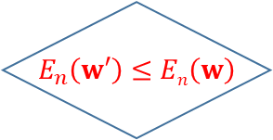
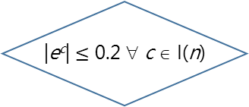
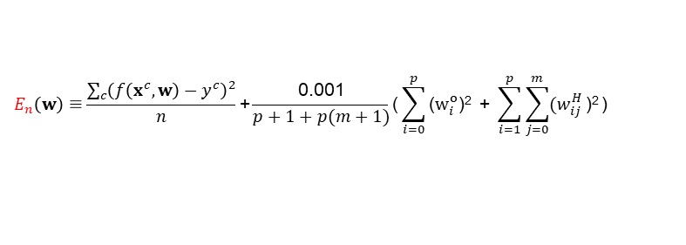

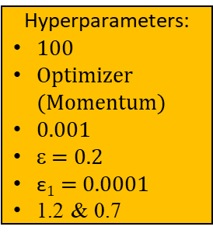
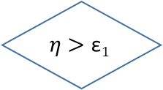

$$E_{n}\left(w\right)≡\frac{\sum_{c}{{\left(f\left(x^{c},w\right)−y^{c}\right)}^{2}}}{n}\text{+}\frac{\text{0.001}}{p+1+p(m+1)}\text{(}\sum_{i=0}^{p}{\text{(}w_{i}^{o}\text{)}\text{2}}\text{ + }\sum_{i=1}^{p}{\sum_{j=0}^{m}{{(w}_{ij}^{H}}\text{)}\text{2}}\text{)}$$
The regularizing module
helps further regularize weights while maintaining an acceptable network.
An acceptable net that accomplishes the learning goal
$$η$$
i = 1
An acceptable net that has a preference on weights
True
i ≥ 100
False
Store w
Hyperparameters:
100
Optimizer (Momentum)
0.001
ε = 0.2
$\text{ε}1$ = 0.0001
1.2 & 0.7
backward operation to obtain $w′$
$w^{′}→w$ $$1.2 η→η$$
i+1 $→$ i
forward operation
Restore w
& $0.7η→η$
$$E_{n}\left(w′\right)≤En\left(w\right)$$
|e^{c}| $≤\text{0.2}$ ∀ c ∈ I(n)
True
True
False
False
True
$$η>\text{ε}1$$
An acceptable net that has a preference on weights
False
Restore w

Slide 25
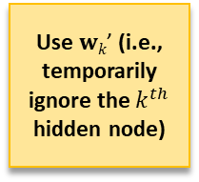
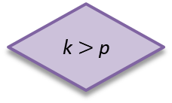

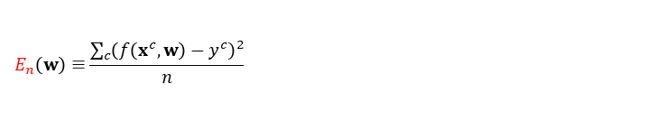

The reorganizing module
helps identify and remove the potentially irrelevant hidden node.
$$E_{n}\left(w\right)≡\frac{\sum_{c}{{\left(f\left(x^{c},w\right)−y^{c}\right)}^{2}}}{n}$$
$$E_{n}\left(w\right)≡\frac{\sum_{c}{{\left(f\left(x^{c},w\right)−y^{c}\right)}^{2}}}{n}\text{+}\frac{\text{0.001}}{p+1+p(m+1)}\text{(}\sum_{i=0}^{p}{\text{(}w_{i}^{o}\text{)}\text{2}}\text{ + }\sum_{i=1}^{p}{\sum_{j=0}^{m}{{(w}_{ij}^{H}}\text{)}\text{2}}\text{)}$$
Restore the network and w
Hyperparameters:
100
Two optimizers (Momentum & Adam)
0.001
Two sets of ε & $\text{ε}1$
(ε = 0.2; $\text{ε}1$ = 0.0001)
Two sets of 1.2 & 0.7
k ++
p --
A
B
An acceptable SLFN
k $>$p
regularizing module
Use $wk\text{’}$ (i.e., temporarily ignore the $k^{th}$ hidden node)
matching module
k = 1
False
Store the network and w
True
An acceptable SLFN
Different loss functions!

Slide 26
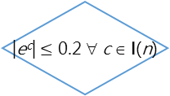
The proposed learning algorithm
(in flowchart)
True
n ≥ N
False
Selecting module
|e^{c}| $≤\text{0.2}$ ∀ c ∈ I(n)
False
Save w
True
A
Matching module
n ++
Reorganizing module
Cramming module
Restore w
B
Initializing module
26

Slide 27
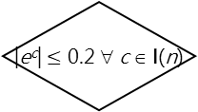
The proposed learning algorithm
(in flowchart)
True
n ≥ N
False
Selecting module
|e^{c}| $≤\text{0.2}$ ∀ c ∈ I(n)
False
Save w
True
Matching module
A
n ++
Reorganizing module
Cramming module
Restore w
B
Initializing module
27

Slide 28
The proposed learning algorithm
(in flowchart)
True
n ≥ N
False
Selecting module
|e^{c}| $≤\text{0.2}$ ∀ c ∈ I(n)
False
Save w
True
Matching module
A
n ++
Reorganizing module
Cramming module
Restore w
B
Initializing module
28

Slide 29
AI Application Problem
(bi_ReLU_mbo)
(1) use q SLFNs with a single output node to mimic a SLFN with q output nodes; (i.e., each SLFN corresponds to the requirement of one output node) (straightforward and much easier)
(2) modify the proposed learning algorithm for a SLFN with multiple output nodes. (i.e., modify each module to fit in the scenario of multiple output nodes) (not straightforward since the modification of a rule-based module needs more mathematical sense and is much harder)

Slide 30
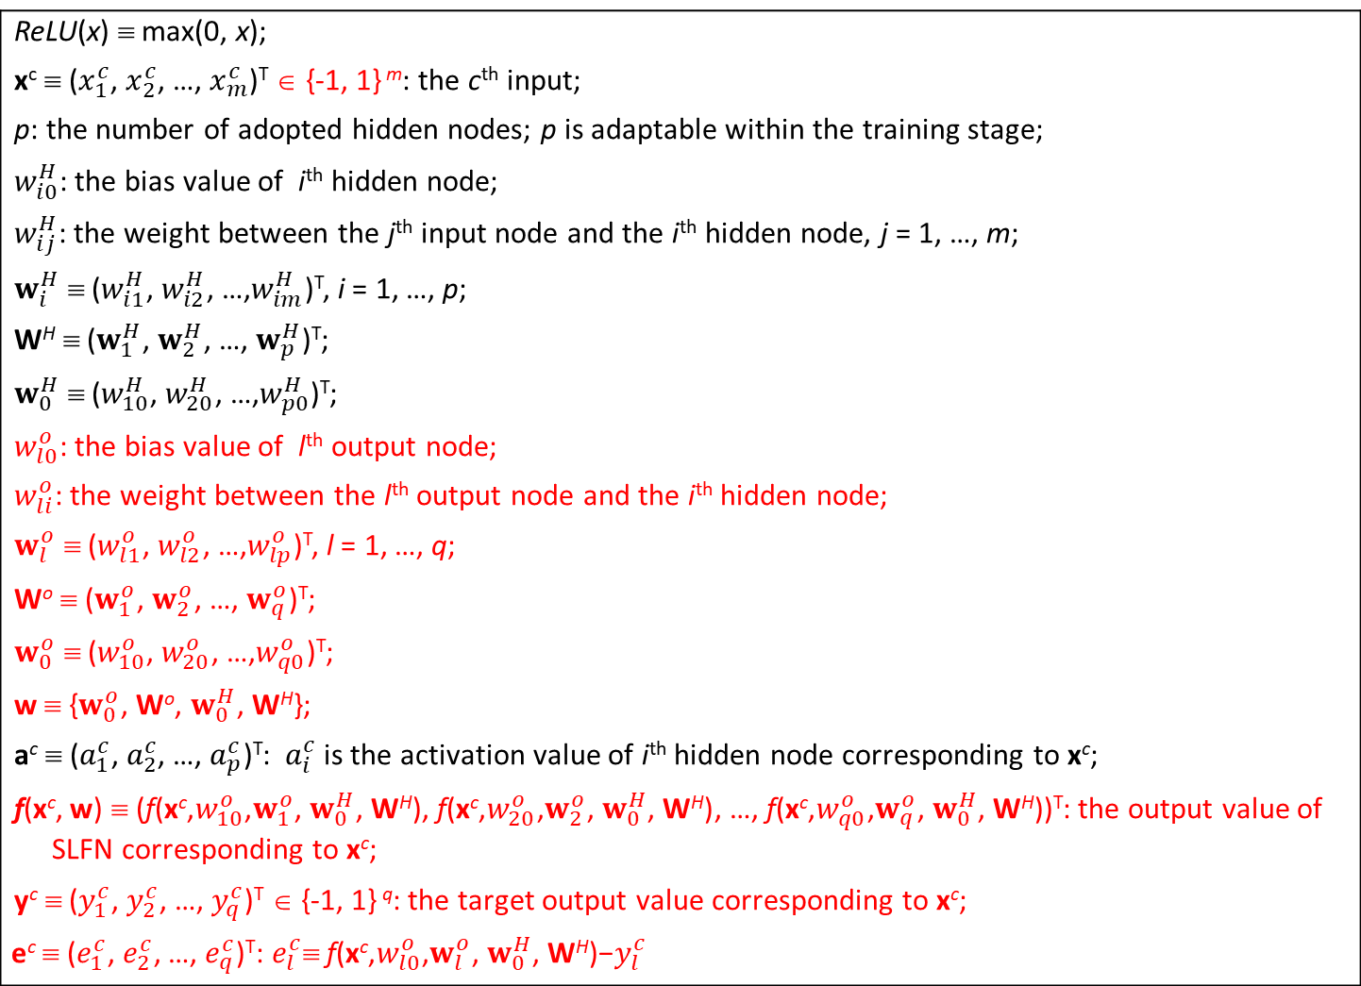
Assumption: the adaptive network
The network setting:
Two-layer nets / SLFN / One-hidden-layer nets
ReLU(x) ≡ max(0, x); x^{c} ≡ ($x_{1}^{c}$, $x_{2}^{c}$, …, $x_{m}^{c}$)^{T} ∈ {-1, 1} ^{m}: the c^{th} input; p: the number of adopted hidden nodes; p is adaptable within the training stage; $w_{i0}^{H}$: the bias value of i^{th} hidden node; $w_{ij}^{H}$: the weight between the j^{th} input node and the i^{th} hidden node, j = 1, …, m; $w_{i}^{H}$ ≡ ($w_{i1}^{H}$, $w_{i2}^{H}$, …,$w_{im}^{H}$)^{T}, i = 1, …, p; W^{H} ≡ ($w_{1}^{H}$, $w_{2}^{H}$, …, $w_{p}^{H}$)^{T}; $w_{0}^{H}$ ≡ ($w_{10}^{H}$, $w_{20}^{H}$, …,$w_{p0}^{H}$)^{T}; $w_{l0}^{o}$: the bias value of l^{th} output node; $w_{li}^{o}$: the weight between the l^{th} output node and the i^{th} hidden node; $w_{l}^{o}$ ≡ ($w_{l1}^{o}$, $w_{l2}^{o}$, …,$w_{lp}^{o}$)^{T}, l = 1, …, q; Wº ≡ ($w_{1}^{o}$, $w_{2}^{o}$, …, $w_{q}^{o}$)^{T}; $w_{0}^{o}$ ≡ ($w_{10}^{o}$, $w_{20}^{o}$, …,$w_{q0}^{o}$)^{T}; w ≡ {$w_{0}^{o}$, Wº, $w_{0}^{H}$, W^{H}}; a^{c} ≡ ($a_{1}^{c}$,${ a}_{2}^{c}$, …, $a_{p}^{c}$)^{T}: $a_{i}^{c}$ is the activation value of i^{th} hidden node corresponding to x^{c}; f(x^{c},$\text{w}$) ≡ ($\text{f}\text{(}\text{x}\text{c}\text{,}w_{10}^{o}\text{,}w_{1}^{o}\text{, }w_{0}^{H}\text{, }\text{W}\text{H}\text{)}$, $\text{f}\text{(}\text{x}\text{c}\text{,}w_{20}^{o}\text{,}w_{2}^{o}\text{, }w_{0}^{H}\text{, }\text{W}\text{H}\text{)}$, …, $\text{f}\text{(}\text{x}\text{c}\text{,}w_{q0}^{o}\text{,}w_{q}^{o}\text{, }w_{0}^{H}\text{, }\text{W}\text{H}\text{)}$)^{T}: the output value of SLFN corresponding to x^{c}; y^{c} ≡ ($y_{1}^{c}$, $y_{2}^{c}$, …, $y_{q}^{c}$)^{T} ∈ {-1, 1} ^{q}: the target output value corresponding to x^{c}; $$\text{e}\text{c} \text{≡}\text{ (}e_{1}^{c}\text{,}{ e}_{2}^{c}\text{, …,} e_{q}^{c}\text{)}\text{T}\text{:} e_{l}^{c}\text{≡} \text{f}\text{(}\text{x}\text{c}\text{,}w_{l0}^{o}\text{,}w_{l}^{o}\text{, }w_{0}^{H}\text{, }\text{W}\text{H}\text{)}\text{−}y_{l}^{c}$$
30

Slide 31





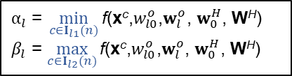

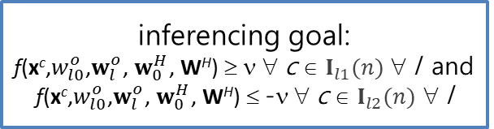

The learning goal of the n^{th} stage
$y_{l}^{c}$ = 1 $∀ c∈I_{l1}$(n); $y_{l}^{c}$ = -1 $∀ c∈I_{l2}$(n);$I$(n) ≡ $I_{l1}$(n) ∪ $I_{l2}$(n)
x: $\text{f}\text{(}\text{x}\text{c}\text{,}w_{l0}^{o}\text{,}w_{l}^{o}\text{, }w_{0}^{H}\text{, }\text{W}\text{H}\text{)} ∀ c∈I_{l1}(n)$
$$α_{l} \text{=} \min_{c∈I_{l1}(n)}{\text{f}\text{(}\text{x}\text{c}\text{,}w_{l0}^{o}\text{,}w_{l}^{o}\text{, }w_{0}^{H}\text{, }\text{W}\text{H}\text{)}}$$
$β_{l}$ = $\max_{c∈I_{l2}(n)}{\text{f}\text{(}\text{x}\text{c}\text{,}w_{l0}^{o}\text{,}w_{l}^{o}\text{, }w_{0}^{H}\text{, }\text{W}\text{H}\text{)}}$
o: $\text{f}\text{(}\text{x}\text{c}\text{,}w_{l0}^{o}\text{,}w_{l}^{o}\text{, }w_{0}^{H}\text{, }\text{W}\text{H}\text{)} ∀ c∈I_{l2}(n)$
$$β_{l}$$
$$α_{l}$$
learning goal: SeC_{l} ∀ l
o
o
o
x
x
o
x
x
$$\text{f}\text{(}\text{x}\text{c}\text{,}w_{l0}^{o}\text{,}w_{l}^{o}\text{, }w_{0}^{H}\text{, }\text{W}\text{H}\text{)}$$
$$−v$$
$$v$$
inferencing goal:
$\text{f}\text{(}\text{x}\text{c}\text{,}w_{l0}^{o}\text{,}w_{l}^{o}\text{, }w_{0}^{H}\text{, }\text{W}\text{H}\text{)}$ ≥ ν ∀ c ∈ $I_{l1}(n)$ ∀ l and $\text{f}\text{(}\text{x}\text{c}\text{,}w_{l0}^{o}\text{,}w_{l}^{o}\text{, }w_{0}^{H}\text{, }\text{W}\text{H}\text{)}$ ≤ -ν ∀ c ∈ $I_{l2}(n)$ ∀ l
o
o
o
o
x
x
x
x
$$\text{f}\text{(}\text{x}\text{c}\text{,}w_{l0}^{o}\text{,}w_{l}^{o}\text{, }w_{0}^{H}\text{, }\text{W}\text{H}\text{)}$$
Undecided

Slide 32



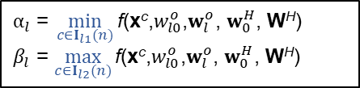






The acceptance is based on the SeC
Acceptance is applied to not only the SLFN but also each individual training data.
$y_{l}^{c}$ = 1 $∀ c∈I_{l1}$(n); $y_{l}^{c}$ = -1 $∀ c∈I_{l2}$(n);$I$(n) ≡ $I_{l1}$(n) ∪ $I_{l2}$(n)
x: $\text{f}\text{(}\text{x}\text{c}\text{,}w_{l0}^{o}\text{,}w_{l}^{o}\text{, }w_{0}^{H}\text{, }\text{W}\text{H}\text{)}, ∀ c∈I_{l1}(n)$
o: $\text{f}\text{(}\text{x}\text{c}\text{,}w_{l0}^{o}\text{,}w_{l}^{o}\text{, }w_{0}^{H}\text{, }\text{W}\text{H}\text{)}, ∀ c∈I_{l2}(n)$
$$α_{l}$$
$$β_{l}$$
$$α_{l} \text{=} \min_{c∈I_{l1}(n)}{\text{f}\text{(}\text{x}\text{c}\text{,}w_{l0}^{o}\text{,}w_{l}^{o}\text{, }w_{0}^{H}\text{, }\text{W}\text{H}\text{)}}$$
$β_{l}$ = $\max_{c∈I_{l2}(n)}{\text{f}\text{(}\text{x}\text{c}\text{,}w_{l0}^{o}\text{,}w_{l}^{o}\text{, }w_{0}^{H}\text{, }\text{W}\text{H}\text{)}}$
o
o
x
o
x
o
x
x
$$β_{l}$$
$$α_{l}$$
$$\text{f}\text{(}\text{x}\text{c}\text{,}w_{l0}^{o}\text{,}w_{l}^{o}\text{, }w_{0}^{H}\text{, }\text{W}\text{H}\text{)}$$
$$α_{l}$$
$$β_{l}$$
o
o
o
x
x
o
x
x
o
o
o
x
x
o
x
x
$$\text{f}\text{(}\text{x}\text{c}\text{,}w_{l0}^{o}\text{,}w_{l}^{o}\text{, }w_{0}^{H}\text{, }\text{W}\text{H}\text{)}$$
$$\text{f}\text{(}\text{x}\text{c}\text{,}w_{l0}^{o}\text{,}w_{l}^{o}\text{, }w_{0}^{H}\text{, }\text{W}\text{H}\text{)}$$
SeC_{l}: True
SeC_{l} : False
32

Slide 33
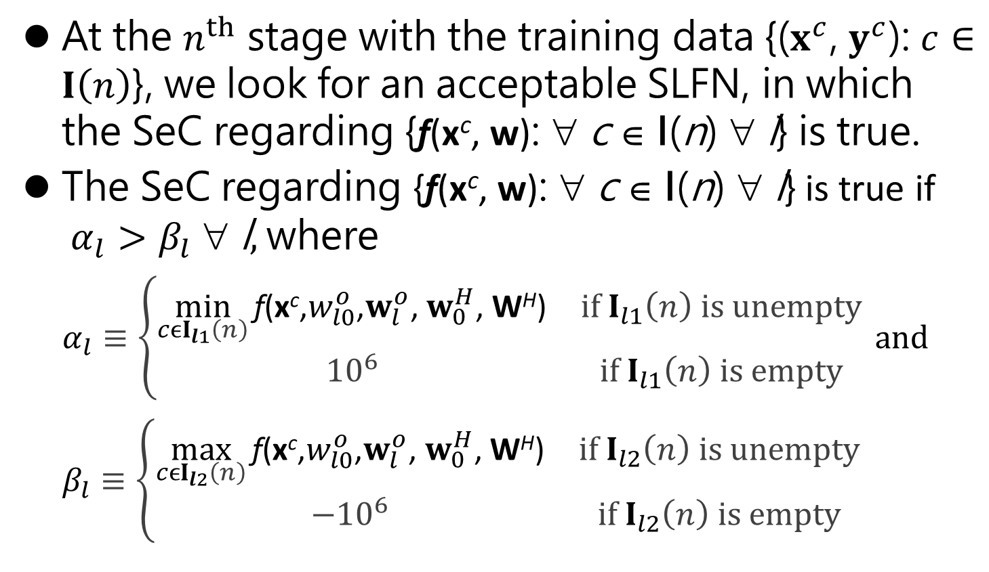

The SeC regarding {$\text{f}\text{(}\text{x}\text{c}\text{,} \text{w}\text{)}$: ∀ c ∈ I(n) $\text{} \text{l}$}
At the $n^{th}$ stage with the training data {($x^{c}$, $y^{c}$): $c∈I\left(n\right)$}, we look for an acceptable SLFN, in which the SeC regarding {$\text{f}\text{(}\text{x}\text{c}\text{,} \text{w}\text{)}\text{:} \text{∀} \text{c} \text{∈ }\text{I}\text{(}\text{n}\text{) ∀} \text{l}$} is true.
The SeC regarding {$\text{f}\text{(}\text{x}\text{c}\text{,} \text{w}\text{)}\text{:} \text{∀} \text{c} \text{∈ }\text{I}\text{(}\text{n}\text{) ∀} \text{l}$} is true if $α_{l}>β_{l} \text{∀} \text{l},$where
$$α_{l}≡\left\{\begin{matrix}\min_{cϵI_{l1}\left(n\right)}{\text{f}\text{(}\text{x}\text{c}\text{,}w_{l0}^{o}\text{,}w_{l}^{o}\text{, }w_{0}^{H}\text{, }\text{W}\text{H}\text{)}} & if I_{l1}\left(n\right) is unempty \\ {10}^{6} & if I_{l1}\left(n\right) is empty\end{matrix}\right. and$$
$$β_{l}≡\left\{\begin{matrix}\max_{cϵI_{l2}\left(n\right)}{\text{f}\text{(}\text{x}\text{c}\text{,}w_{l0}^{o}\text{,}w_{l}^{o}\text{, }w_{0}^{H}\text{, }\text{W}\text{H}\text{)}} & if I_{l2}\left(n\right) is unempty \\ {−10}^{6} & if I_{l2}\left(n\right) is empty\end{matrix}\right.$$

Slide 34
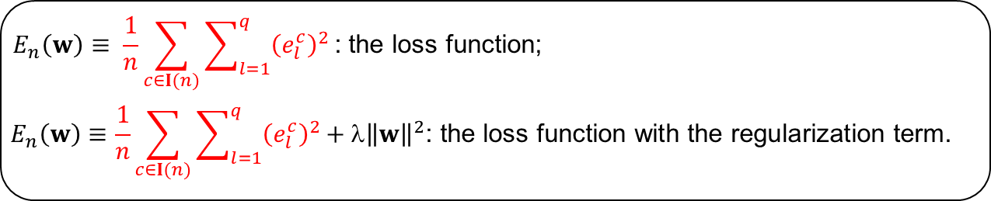
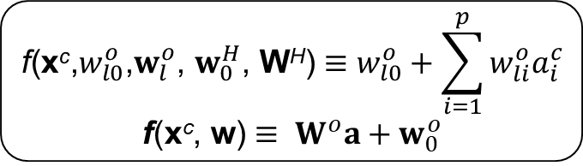
Forward operation
The forward operation setting
Hidden Layer
The hidden layer:
i
$$a_{i}^{c}≡\operatorname{ReLU}\left(w_{i0}^{H}+\sum_{j=1}^{m}{w_{ij}^{H}}x_{j}^{c}\right)$$
$$a≡\operatorname{ReLU}\left(W^{H}x+w_{0}^{H}\right)$$
Input Layer
$$x_{1}$$
$$x_{2}$$
$$x_{3}$$
…
$$x_{m}$$
Output Layer
The output layer:
l
$$\text{f}\text{(}\text{x}\text{c}\text{,}w_{l0}^{o}\text{,}w_{l}^{o}\text{, }w_{0}^{H}\text{, }\text{W}\text{H}\text{)}≡w_{l0}^{o}+\sum_{i=1}^{p}{w_{li}^{o}a_{i}^{c}}$$
$$\text{f}\text{(}\text{x}\text{c}\text{,} \text{w}\text{)}≡{ W}^{o}a+w_{0}^{o}$$
Hidden Layer
1
2
…
p
$$E_{n}\left(w\right)≡ \frac{1}{n}\sum_{c∈I(n)}{\sum_{l=1}^{q}{{\left(e_{l}^{c}\right)}^{2}}}\text{: }\text{the} \text{loss} \text{function}\text{;}$$
$$E_{n}\left(w\right)≡\frac{1}{n}\sum_{c∈I(n)}{\sum_{l=1}^{q}{{\left(e_{l}^{c}\right)}^{2}}}\text{+ }\text{λ}{\left\|w\right\|}^{2}\text{: }\text{the} \text{loss} \text{function} \text{with} \text{the} \text{regularization} \text{term}\text{.}$$
Notes:
The Single-hidden layer Feedforward Neural Networks (SLFN) structure

Slide 35
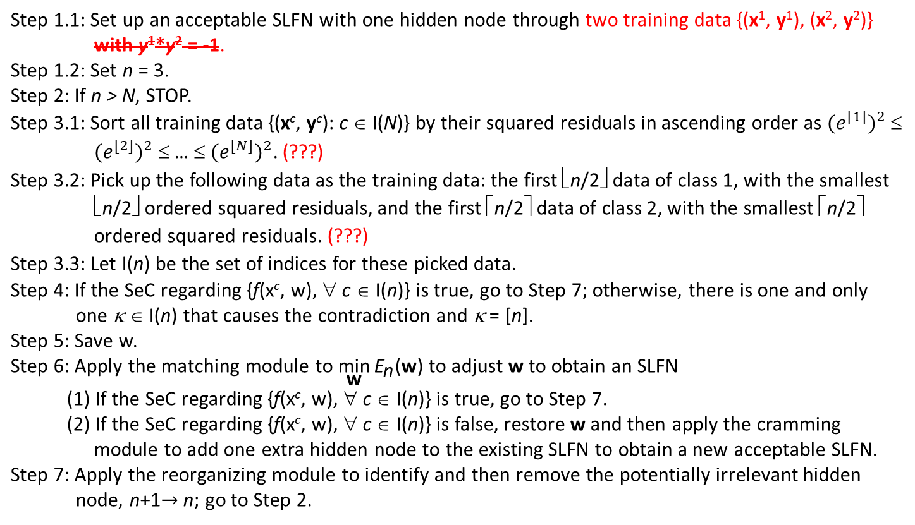
The proposed learning algorithm
Step 1.1: Set up an acceptable SLFN with one hidden node through two training data {(x¹, y¹), (x², y²)} with y¹*y² = -1. Step 1.2: Set n = 3. Step 2: If n > N, STOP. Step 3.1: Sort all training data {(x^{c}, y^{c}): c ∈ I(N)} by their squared residuals in ascending order as ${(e^{[1]})}^{2}$ ≤ ${(e^{[2]})}^{2}$ ≤ … ≤ ${(e^{[N]})}^{2}$. (???) Step 3.2: Pick up the following data as the training data: the first ⎣n/2⎦ data of class 1, with the smallest ⎣n/2⎦ ordered squared residuals, and the first ⎡n/2⎤ data of class 2, with the smallest ⎡n/2⎤ ordered squared residuals. (???) Step 3.3: Let I(n) be the set of indices for these picked data. Step 4: If the SeC regarding {f(x^{c}, w), ∀ c ∈ I(n)} is true, go to Step 7; otherwise, there is one and only one κ ∈ I(n) that causes the contradiction and κ = [n]. Step 5: Save w. Step 6: Apply the matching module to $\underset{\text{w}}{\text{min}}{{\text{E}}_{\text{n}}\text{(}\text{w}\text{)}}$ to adjust w to obtain an SLFN (1) If the SeC regarding {f(x^{c}, w), ∀ c ∈ I(n)} is true, go to Step 7. (2) If the SeC regarding {f(x^{c}, w), ∀ c ∈ I(n)} is false, restore w and then apply the cramming module to add one extra hidden node to the existing SLFN to obtain a new acceptable SLFN. Step 7: Apply the reorganizing module to identify and then remove the potentially irrelevant hidden node, n+1$→$n; go to Step 2.
math validation ← ???
Rule-based methods: much easier to be proved by mathematical proofs, but the validation is usually required and difficult.
math validation ← ???

Slide 36
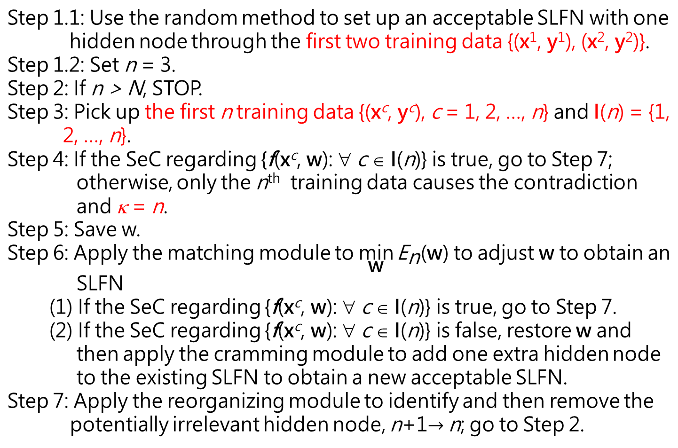
The proposed learning algorithm
Step 1.1: Use the random method to set up an acceptable SLFN with one hidden node through the first two training data {(x¹, y¹), (x², y²)}. Step 1.2: Set n = 3. Step 2: If n > N, STOP. Step 3: Pick up the first n training data {(x^{c}, y^{c}), c = 1, 2, …, n} and I(n) = {1, 2, …, n}. Step 4: If the SeC regarding {f(x^{c}, w): ∀ c ∈ I(n)} is true, go to Step 7; otherwise, only the n^{th} training data causes the contradiction and κ = n. Step 5: Save w. Step 6: Apply the matching module to $\underset{\text{w}}{\text{min}}{{\text{E}}_{\text{n}}\text{(}\text{w}\text{)}}$ to adjust w to obtain an SLFN (1) If the SeC regarding {f(x^{c}, w): ∀ c ∈ I(n)} is true, go to Step 7. (2) If the SeC regarding {f(x^{c}, w): ∀ c ∈ I(n)} is false, restore w and then apply the cramming module to add one extra hidden node to the existing SLFN to obtain a new acceptable SLFN. Step 7: Apply the reorganizing module to identify and then remove the potentially irrelevant hidden node, n+1$→$n; go to Step 2.
initializing
No math validation required
stopping criterion
selecting
No math validation required
learning goal
No math validation required
Math validation required

Slide 37

The proposed learning algorithm
(in flowchart)
True
n ≥ N
False
$${PO}_{n}^{N}$$
SeC
False
Save w
True
Matching module
A
n ++
Reorganizing module
Cramming module
Restore w
B
Initializing module
37

Slide 38

The initializing module
Step 1: Use the random method to set up an acceptable SLFN with one hidden node through the first two training data {(x¹, y¹), (x², y²)}.
Step 2: Set n = 3.
The stopping criterion
If n > N, STOP.
The ${PO}_{n}^{N}$ module
At the n^{th} stage:
Pick up the first n training data {(x^{c}, y^{c}): c = 1, 2, …, n} and I(n) = {1, 2, …, n}.

Slide 39
The learning goal
SeC
The save module
Save w
The restore module
Restore the saved w

Slide 40
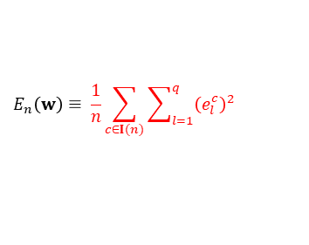
The matching module
helps tune weights to obtain an acceptable net.
Hyperparameters:
100
Optimizer (Adam)
ε = 0.001
i = 1
$$E_{n}\left(w\right)≡ \frac{1}{n}\sum_{c∈I(n)}{\sum_{l=1}^{q}{{\left(e_{l}^{c}\right)}^{2}}}$$
i++
forward
operation
False
i ≥ 100
SeC
backward operation
False
True
True
B
Unacceptable net
Acceptable net
A

Slide 41
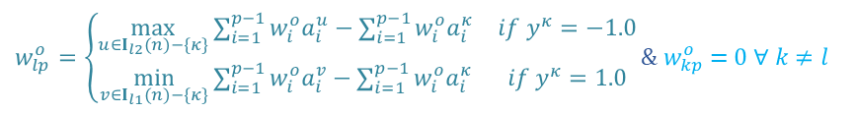

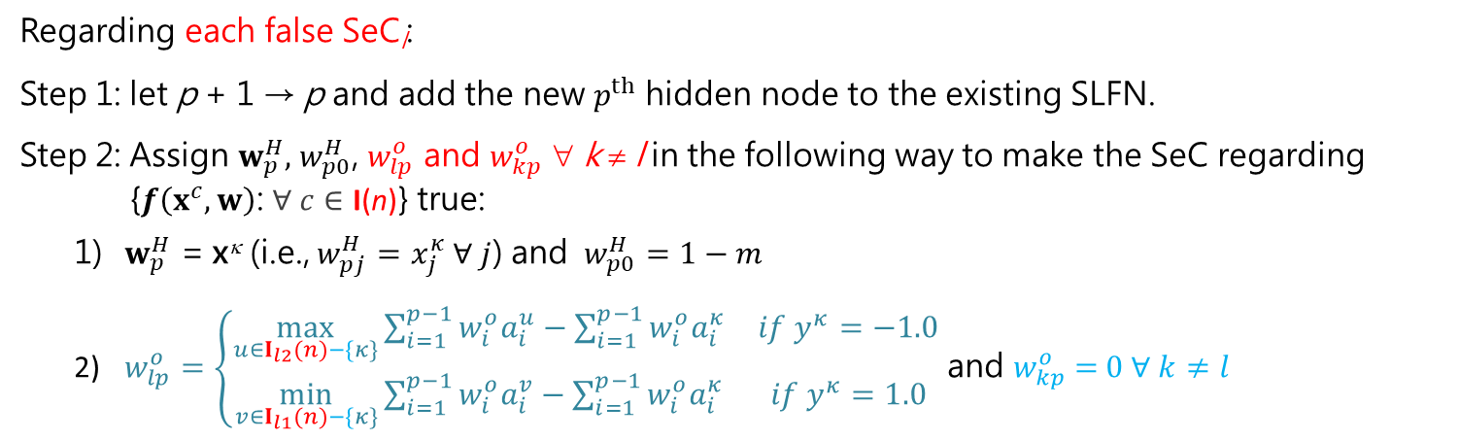

The cramming module
Regarding each false SeC_{l}:
Step 1: let p + 1 → p and add the new $p^{th}$ hidden node to the existing SLFN.
Step 2: Assign $w_{p}^{H},$ $w_{p0}^{H}$, $w_{lp}^{o}$ and $w_{kp}^{o}$ ∀ k ≠ l in the following way to make the SeC regarding {$f\left(x^{c},w\right)$: $∀ c∈\text{I}\text{(}\text{n}\text{)}$} true:
$w_{p}^{H}$ = x^{κ} (i.e., $w_{pj}^{H}=x_{j}^{κ}$ $∀ j$) and $w_{p0}^{H}=1−m$
$w_{lp}^{o}=\left\{\begin{matrix}\max_{u∈I_{l2}(n)−\{κ\}}{\sum_{i=1}^{p−1}{w_{i}^{o}a_{i}^{u}−\sum_{i=1}^{p−1}{w_{i}^{o}a_{i}^{κ}}}} & if{ y}^{κ}=−1.0 \\ \min_{v∈I_{l1}(n)−\{κ\}}{\sum_{i=1}^{p−1}{w_{i}^{o}a_{i}^{v}}}−\sum_{i=1}^{p−1}{w_{i}^{o}a_{i}^{κ}} & if{ y}^{κ}=1.0\end{matrix}\right.$ and $w_{kp}^{o}$ = $0 ∀ k≠l$
1
…
l
…
q
$w_{lp}^{o}=\left\{\begin{matrix}\max_{u∈I_{l2}(n)−\{κ\}}{\sum_{i=1}^{p−1}{w_{i}^{o}a_{i}^{u}−\sum_{i=1}^{p−1}{w_{i}^{o}a_{i}^{κ}}}} & if{ y}^{κ}=−1.0 \\ \min_{v∈I_{l1}(n)−\{κ\}}{\sum_{i=1}^{p−1}{w_{i}^{o}a_{i}^{v}}}−\sum_{i=1}^{p−1}{w_{i}^{o}a_{i}^{κ}} & if{ y}^{κ}=1.0\end{matrix}\right.$ & $w_{kp}^{o}$ = $0 ∀ k≠l$
1
2
3
…
p
$w_{p0}^{H}$ = $1−m$
$w_{pj }^{H}$= $x_{j}^{κ}$ $∀ j$
1
2
……
m

Slide 42
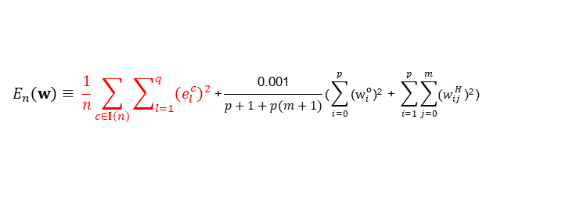
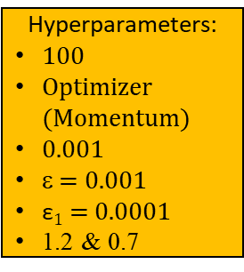

$$E_{n}\left(w\right)≡ \frac{1}{n}\sum_{c∈I(n)}{\sum_{l=1}^{q}{{\left(e_{l}^{c}\right)}^{2}}}\text{+}\frac{\text{0.001}}{p+1+p(m+1)}\text{(}\sum_{i=0}^{p}{\text{(}w_{i}^{o}\text{)}\text{2}}\text{ + }\sum_{i=1}^{p}{\sum_{j=0}^{m}{{(w}_{ij}^{H}}\text{)}\text{2}}\text{)}$$
The regularizing module
helps further regularize weights while maintaining an acceptable network.
An acceptable net that accomplishes the learning goal
$$η$$
i = 1
An acceptable net that has a preference on weights
True
i ≥ 100
False
Store w
Hyperparameters:
100
Optimizer (Momentum)
0.001
ε = 0.001
$\text{ε}1$ = 0.0001
1.2 & 0.7
backward operation to obtain $w′$
$w^{′}→w$ $$1.2 η→η$$
i+1 $→$ i
forward operation
Restore w
& $0.7η→η$
$$E_{n}\left(w′\right)≤En\left(w\right)$$
SeC
True
True
False
False
True
$$η>\text{ε}1$$
An acceptable net that has a preference on weights
False
Restore w

Slide 43
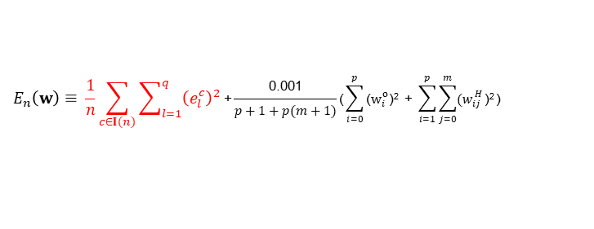
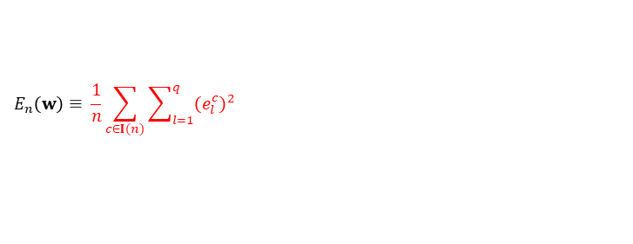

The reorganizing module
helps identify and remove the potentially irrelevant hidden node.
$$E_{n}\left(w\right)≡ \frac{1}{n}\sum_{c∈I(n)}{\sum_{l=1}^{q}{{\left(e_{l}^{c}\right)}^{2}}}$$
$$E_{n}\left(w\right)≡ \frac{1}{n}\sum_{c∈I(n)}{\sum_{l=1}^{q}{{\left(e_{l}^{c}\right)}^{2}}}\text{+}\frac{\text{0.001}}{p+1+p(m+1)}\text{(}\sum_{i=0}^{p}{\text{(}w_{i}^{o}\text{)}\text{2}}\text{ + }\sum_{i=1}^{p}{\sum_{j=0}^{m}{{(w}_{ij}^{H}}\text{)}\text{2}}\text{)}$$
Restore the network and w
Hyperparameters:
100
Two optimizers (Momentum & Adam)
0.001
Two sets of ε & $\text{ε}1$
(ε = 0.001; $\text{ε}1$ = 0.0001)
Two sets of 1.2 & 0.7
k ++
p --
A
B
An acceptable SLFN
k $>$p
regularizing module
Use $wk\text{’}$ (i.e., temporarily ignore the $k^{th}$ hidden node)
matching module
k = 1
False
Store the network and w
True
An acceptable SLFN
Different loss functions!

Slide 44
The proposed learning algorithm
(in flowchart)
True
n ≥ N
False
$${PO}_{n}^{N}$$
SeC
False
Save w
True
A
Matching module
Reorganizing module
n ++
Cramming module
Restore w
B
Initializing module
44

Slide 45
The proposed learning algorithm
(in flowchart)
True
n ≥ N
False
$${PO}_{n}^{N}$$
SeC
False
Save w
True
Matching module
A
n ++
Reorganizing module
Cramming module
Restore w
B
Initializing module
45

Slide 46
The proposed learning algorithm
(in flowchart)
True
n ≥ N
False
$${PO}_{n}^{N}$$
SeC
False
Save w
True
Matching module
A
n ++
Reorganizing module
Cramming module
Restore w
B
Initializing module
46

Slide 47
Validate the algorithm
Cannot validate any learning algorithm through the mathematical proof.
Cannot merely check the correctness of codes.
Learning algorithm → learning process ← Check whether the corresponding learning process does display the proposed ideas/concepts.
Check whether the proposed learning algorithm does lead to good performances in specific AI applications.

